Slide 1
Powernet :Tech. for ‘smart’ grid
Project Final Presentation
Sponsor : SLAC Point of contact : Sila Kiliccote Faculty Advisor : Prof Osman Yagan Team : Bixian,Yizhe,Cory,Praveen
INI Project Practicum, Fall 2015

Slide 2
Sponsors
Work for “Bits And Watts” group initiative at Stanford
SLAC center to define next generation “smart”
electric grid system.

Slide 3
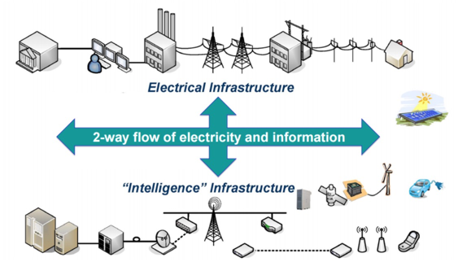
Motivation : The Future

Slide 4
Motivation : “Smart Grid”
Incorporation of renewable energy to the electric grid ( eg.Solar Panels)
Empower consumers to use energy based on dynamic rate fluctuation (eg. electric car)
Reduces expense to the power producer
Facilitates real time trouble shooting (eg. PSL devices)

Slide 5
Use Case: Demand Response

Slide 6
Use Case – Related Work

Slide 7
System Design

Slide 8
System Implementation

Slide 9
Demo

Slide 10
Project : Setup

Slide 11
Known Issues, bugs & Problem

Slide 12
Experiment & Analysis

Slide 13
Next Step

Slide 14

Questions?

